Slide 1
Multinational and Entry-Mode Strategies Content and Formulation
Multinational Management
耿延

Slide 2
Learning Objectives (1 of 2)
Appreciate the complexities of the global-local dilemma facing the multinational company.
Understand the content of the multinational strategies: transnational, international, multi-domestic, & regional.
Formulate a multinational strategy by applying the diagnostic questions that aid MNCs in solving the global-local dilemma.

Slide 3
Learning Objectives (2 of 2)
Understand the content of the entry-mode strategies: exporting, alliances/international joint ventures (IJVs), licensing & foreign direct investment.
Formulate an entry-mode strategy based on the strengths and weaknesses of each approach, and the needs of the MNC.
Understand political risk and how multinational companies can manage such risks.

Slide 4
Multinational Strategies: Dealing with the
Global-Local Dilemma
The Global-Local Dilemma: MNCs face:
  pressures to respond to the unique needs of the markets in each country or region (a local responsiveness solution)
  efficiency pressures that encourage them to de-emphasize local differences, and conduct business similarly throughout the world (a global integration solution)
These conflicting demands represent the Global-local dilemma – to which should the MNC respond?
The MNC’s choice forms its basic strategic orientation.

Slide 5
Multinational Strategies: Dealing with the
Global-Local Dilemma
Four broad multinational strategies offer solutions to the Global-Local dilemma:
    - Multidomestic
    Transnational
    International
    - Regional

Slide 6
Multidomestic Strategy
Multidomestic Strategy: The MNC attempts to offer products or services that attract customers by closely satisfying their cultural needs and expectations
Emphasizes local-responsiveness issues
  - Example: different packages, colors
  - Costs more to produce, so must charge higher prices to recoup costs
  - In many respects, a form of differentiation strategy
  - Not limited to large multinationals

Slide 7
Transnational Strategy
A Transnational Strategy adopts two priorities:
  Seeking location advantages:
    Disperse value chain activities where the MNC can do it best or cheapest, as required.
  Gaining economic efficiencies from operating worldwide:
    Global platform: a country where a firm can best perform some of its value-chain activities, thus gaining a comparative advantage

Slide 8
International Strategy
  International Strategy: the MNC sells products and uses similar marketing techniques worldwide.
  This is a compromise approach to global-local dilemma.
  - Adaptation to local culture is minor, if it exists at all.
  - Upstream and support activities remain concentrated at the MNC’s home country, unlike transnational companies.

Slide 9
Regional Strategy
Regional Strategy: the MNC manages raw-material sourcing, production, marketing, and support activities within a particular region.
  - This is another compromise strategy which attempts to balance between all of the others.
  - A Regional Strategy tries to gain economic advantages from its regional network.
  The relative uniformity of Regional trading blocs may lead to advantages from local adaptation.

Slide 10
A Brief Summary & Caveat
All of the foregoing strategies are general descriptions, and companies seldom adopt them in pure form.
Companies with more than one business may use a different multinational strategy for each unit, and single-business firms may alter strategies to adjust for product differences.
Governmental regulations, the cost of switching strategies, and other factors may prevent full implementation of any given strategy.

Slide 11
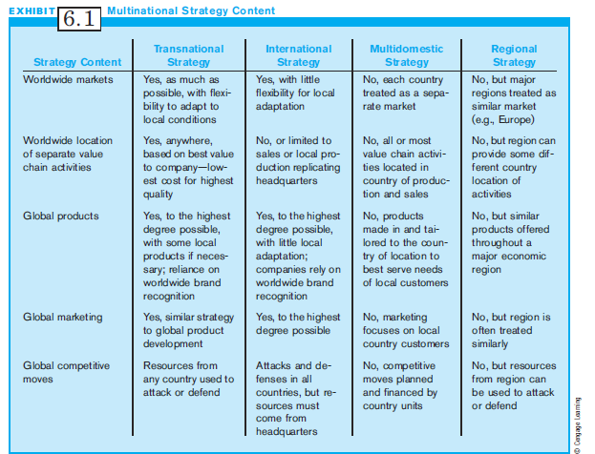
Exhibit 6.1:
Multinational Strategy Content

Slide 12
Resolving the Global-Local Dilemma: Formulating a Multinational Strategy
Selection of a strategy depends on the degree of globalization in the MNC’s industry.
Globalization drivers are conditions in an industry that favor transnational or international strategies.
Four categories of Global Drivers:
  Global Markets
  Costs
  Governments
  Competition

Slide 13
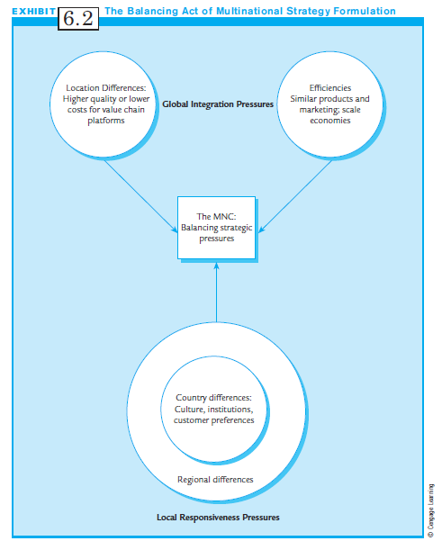
Exhibit 6.2:
The Balancing Act of Multinational Strategy Formulation

Slide 14
Globalization Drivers (1 of 2)
Global Markets:
  Are there common customer needs?
  Are there global customers?
  Can you transfer marketing?
Costs:
  Are there global economies of scale?
  Are there cheaper sources of low-cost raw materials?
  Are there cheaper sources of highly skilled labor?

Slide 15
Globalization Drivers (2 of 2)
Governments:
  Do the targeted countries have favorable trade policies?
  Do the target countries have regulations that restrict operations?
The Competition:
  What strategies do your competitors use?
  What is the volume of imports and exports in the industry?

Slide 16
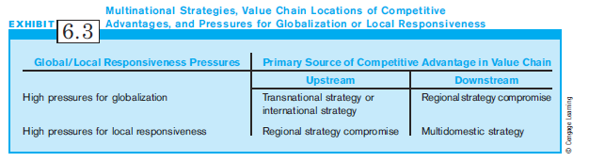
Exhibit 6.3:
Multinational Strategies, and
Pressures for Globalization or
Local Responsiveness

Slide 17
Transnational or International: Which Way for the Global Company?
Select a transnational over an international strategy when:
  Benefits of dispersing activities worldwide offset the costs of coordinating a more complex organization
Select an international strategy over a transnational when:
  Cost savings of centralization offset the lower costs of higher quality raw materials/labor from worldwide locations

Slide 18
Entry-Mode Strategies:
The Content Options
Entry-Mode Strategies are options for entering foreign markets and countries:
  Exporting
  - Licensing
  - International Strategic Alliances
  - Foreign Direct Investment

Slide 19
Exporting
Exporting is the easiest way to sell a product in international market
A passive exporter is a company that treats and fills overseas orders like domestic orders.
At the other extreme, MNCs can put extensive resources into exporting.
After moving beyond passive exporting, two strategies:
  Indirect
  Direct

Slide 20
Export Strategies (1 of 2)
Indirect exporting: intermediaries or go-between firms provide knowledge and contacts overseas.
The most common intermediaries:
- Export Management Company (EMC)
    Specialize in products, countries, or regions
    Provide ready-made access to markets
    Have networks of foreign distributors
- Export Trading Company (ETC)
    Takes title to product before exporting

Slide 21
Export Strategies (2 of 2)
Direct exporting: The MNC takes on duties of intermediaries and make direct contact with customers in the foreign market.
  More aggressive exporting strategy
  Requires more contact with foreign companies
  Uses foreign sales representatives, distributors, or retailers
  May require own branch offices in foreign countries

Slide 22
Licensing
Licensing: A contractual agreement between a domestic licensor and a foreign licensee
Licensor has valuable patent, know-how, or trademark
Foreign licensee pays royalties for use
Provides easiest, least risky, and most low cost way to go international

Slide 23
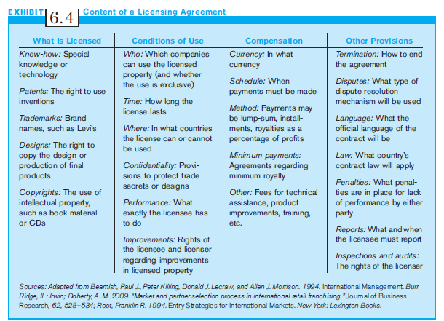
Exhibit 6.4:
Contents of a Licensing Agreement

Slide 24
Special Licensing Agreements
International franchising: The franchisor grants the use of a whole business operation to the franchisee.
Contract manufacturing: This represents production by a firm following the foreign company’s specifications.
Turnkey operation: A multinational company makes a project fully operational before turning it over to the foreign owner.

Slide 25
International Strategic Alliances
International strategic alliances are cooperative agreements between firms from different countries to participate in business activities.
Activities may include any value chain activity from R&D to sales and service.
One of the dominant entry-mode strategies for MNCs

Slide 26
Foreign Direct Investment (FDI)
In Foreign Direct Investment (FDI), an MNC owns part of all of a foreign operation.
  International Joint Ventures (IJVs) are a form of FDI
FDI reflects the highest stage of internationalization
Greenfield investments: using FDI to start a foreign subsidiary from scratch

Slide 27
Formulating an
Entry-mode Strategy
Must take into account several issues:
  - Basic functions of each entry-mode strategy
  - Strategic considerations regarding the company and its strategic intent, products, and markets
  - How best to support company’s multinational strategy

Slide 28
Basic Functions of
Entry-mode Strategies: Exporting
(1 of 3)
Deciding on an Export Strategy; Managers should ask:
  Does management need to control foreign sales, customer credit, and sale of the product to the customer?
    If yes, choose direct exporting
  Does company have financial and human resources to create positions to manage export operations?
    If not, use indirect exporting; rely on intermediaries.

Slide 29
Basic Functions of
Entry-mode Strategies: Exporting
(2 of 3)
Does company have resources to design and execute international promotional activities in foreign language?
  If not, use foreign intermediaries and indirect exporting
Does company have resources to support extensive international travel or possibly an expatriate sales
force?
  If so, choose direct exporting.

Slide 30
Basic Functions of
Entry-mode Strategies: Exporting
(3 of 3)
Does company have time and expertise to develop its own overseas contacts and networks?
- If not, rely on foreign intermediaries or choose indirect exporting.
Will time and resources affect domestic operations?
- If not, choose direct exporting.

Slide 31
When Should an MNC License?
The decision to license is based on three factors:
  - Characteristics of the products
    Best products are older or soon-to-be replaced
  - Characteristics of the target country
    Situation in target country
  - Nature of the licensing company
    Company may lack resources to go international

Slide 32
Some Disadvantages of Licensing
Four major drawbacks:
  The MNC gives up control.
  The firm may create new competitors.
  Licenses often generate only low revenues.
  Opportunity costs: The MNC loses opportunities to enter the country through other means such as exporting or FDI.

Slide 33
Advantages and Disadvantages of
Foreign Direct Investment (FDI)
All but the most experienced international firms try other forms of entry before they selct FDI.
Exporting, licensing or alliances can prepare a firm for FDI and minimize chances of failure.
Among advantages, greater control of marketing, avoids import quotas, better local image of product.
Among disadvantages, increased capital investment, drain on managerial talent, greater exposure to financial risks.

Slide 34
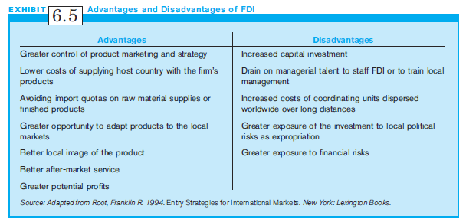
Exhibit 6.5:
Advantages & Disadvantages of FDI

Slide 35
The Control vs. Risk Tradeoff:
The Need for Control (1 of 2)
A firm going international must ask how important it is to monitor and control overseas operations.
Key areas of concern over control are:
  Product quality in the manufacturing process
  Product price
  Advertising
  Other promotional activities
  Where the product is sold
  After market service

Slide 36
The Control vs. Risk Tradeoff:
The Need for Control (2 of 2)
Usually, entry-mode choices that increase control entail greater risk.
  Example: Exporting and licensing are low-risk, but they surrender control over the product or service.
FDI allows firms to maximize control, but also expose the firm to the greatest financial and political risks.

Slide 37
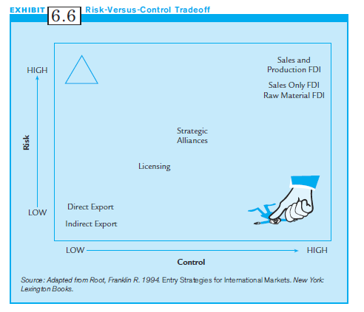
Exhibit 6.6:
Risk versus Control Tradeoff

Slide 38
Entry-mode Strategies &
Multinational Strategies (1 of 2)
To determine an entry-mode & multi-national strategy, ask these questions:
  Which entry-mode strategy best serves the firm’s objectives for being in the country or region?
  Is the strategic intent to learn the market or to become immediately profitable?
  What are the company’s resources in finances and international expertise?
  Are local government regulations favorable or not?

Slide 39
Entry-mode Strategies &
Multinational Strategies (2 of 2)
To determine an entry-mode & multi-national strategy, ask these questions (cont’d):
  What is the geography of the area? Is there a long distance between markets?
  Are there significant cultural differences between the firm and the markets?
  What is the firm’s need for control in this instance?

Slide 40
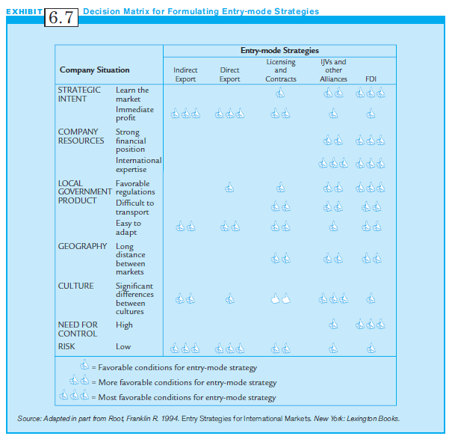
Exhibit 6.7:
Decision Matrix for Formulating
Entry-mode Strategies

Slide 41
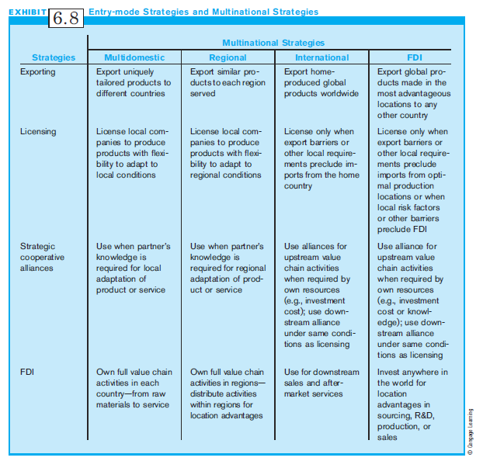
Exhibit 6.8:
Entry-mode Strategies &
Multinational Strategies

Slide 42
Political Risk (1 of 2)
Political Risk refers to the impact of political decisions or events on the business climate in a country such that a multinational’s profitability and feasibility of its global operations are negatively affected.
Examples:
  Russia’s politically motivated jailing of Mikhail Khodorkovsky, the business tycoon
  The Ukraine’s recent disputed elections, resulting in presidential uncertainties

Slide 43
Political Risk (2 of 2)
Why should a multinational company be concerned about political risk?
  Such risk can have a serious impact on its profitability.
  The world is dependent on energy coming from locations with high political risk.
  The world is so interconnected, political uncertainties in one country can have worldwide impact.

Slide 44
Political Risk Assessment (1 of 3)
Some of the factors that influence political risk in a society:
  Changes in the government
  A sudden shift in governmental policies or ideology
  Social volatility
  The passage of new laws
  Leadership changes and the potential for related unrest
  The level of corruption
  All factors that may politically stabilize or destabilize a country

Slide 45
Political Risk Assessment (2 of 3)
To assess these factors, ask:
  How durable and resilient is the political system?
  How peaceful have governmental transitions been in the past?
  What roles do other nongovernmental organizations play in the country’s political stability?
  Are there internal factors that could result in social unrest or civil war?

Slide 46
Political Risk Assessment (3 of 3)
To assess these factors, ask (cont’d):
  What is the level of corruption?
  How reliable is the rule of law?
  What is the likelihood that the country can be hit by natural disasters?

Slide 47
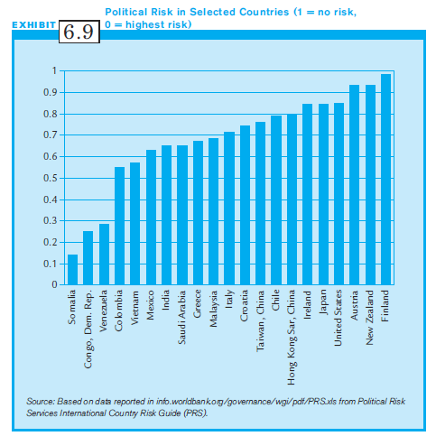
Exhibit 6.9:
Political Risk in
Selected Countries

Slide 48
Managerial Implications:
Political Risk (1 of 2)
To manage political risk, consider:
  Insurance from private or government agencies if available and affordable, for
    Political risk
    Political violence
    Foreign currency inconvertibility
    Expropriation
    Interference with business operations

Slide 49
Managerial Implications:
Political Risk (2 of 2)
To manage political risk, consider (cont’d):
  Rely on local partners to mitigate political risks.
    Example: Japan’s Sumito Chemical entered into joint venture with Saudi Arabia’s Aramco to build a major petrochemical plant in Saudi Arabia.
  Take a high involvement strategy by developing a network of government, business and public partners to help face local political risks.

Slide 50
Summary
Multinational manager faces array of complex strategic issues.
All companies must deal with global-local dilemma.
Multinationals also face the challenges of choosing entry-mode strategies.
Political risk is also becoming an important component of investment decisions overseas.

